Slide 1
Enterprise Programmering 1 Lesson 09: Selenium and JaCoCo
Dr. Andrea Arcuri
Westerdals Oslo ACT
University of Luxembourg

Slide 2
About these slides
These slides are just high level overviews of the topics covered in class
The details are directly in the code comments on the Git repository

Slide 3
Software Testing

Slide 4

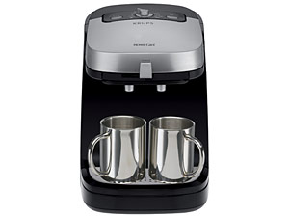
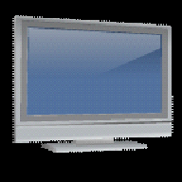
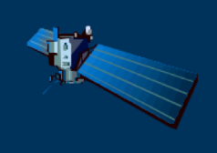
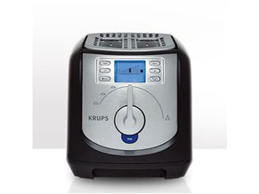


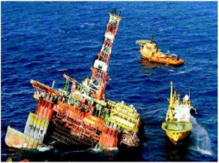
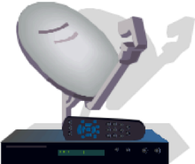



Software is everywhere!!! (not just enterprise systems…)

Slide 5
Are software applications doing what are they supposed to do?

Slide 6
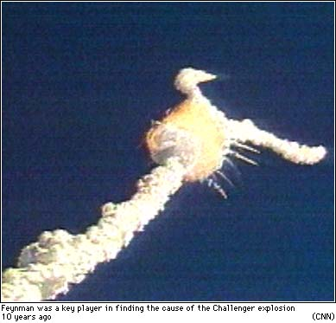
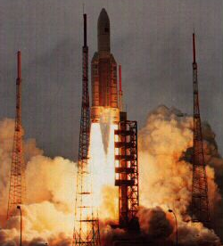
Ariane 5 – ESA
On June 4, 1996, the flight of the Ariane 5 launcher ended in a failure.
$500 millions in cost
Software bug

Slide 7

F-18 crash
An F-18 crashed because of a missing exception condition, thought not possible…

Slide 8
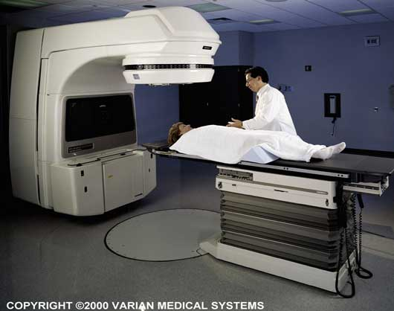
Fatal Therac-25 Radiation
1986, Texas, person died

Slide 9

Power Shutdown in 2003
Nearly 50 million people affected in Canada/US

Slide 10
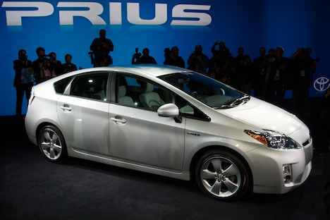
2010, Toyota, bug in braking system, recalled 436,000 vehicles…

Slide 11
Knight Capital Group 2012
$460 millions lost in 45 minutes of trading due to bug

Slide 12
And I could go on the whole day…
As of 2013, estimated that software testing costing $312 billions worldwide
In 2016, 548 recorded and documented software failures impacted 4.4 billion people and $1.1 trillion in assets worldwide

Slide 13
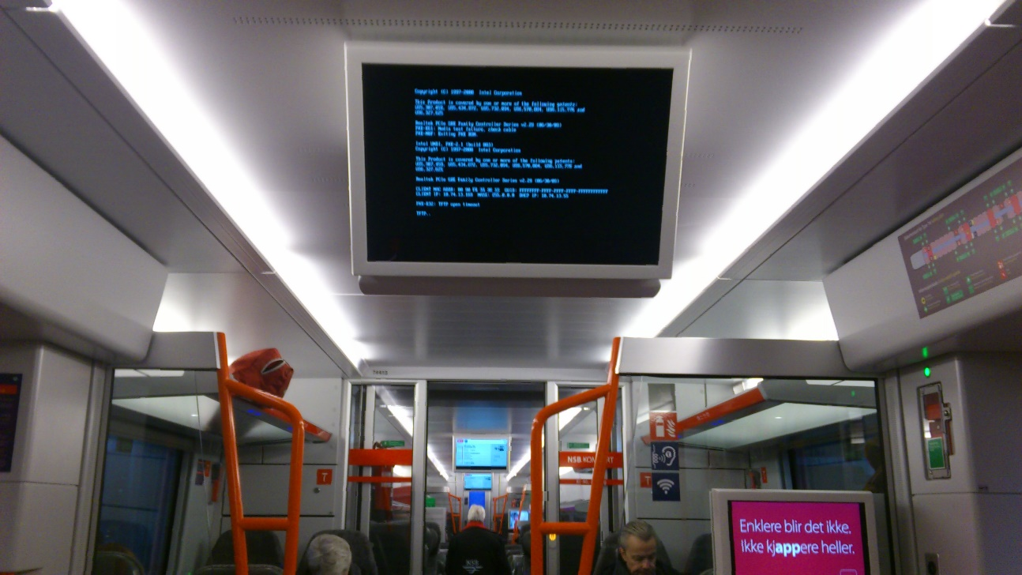
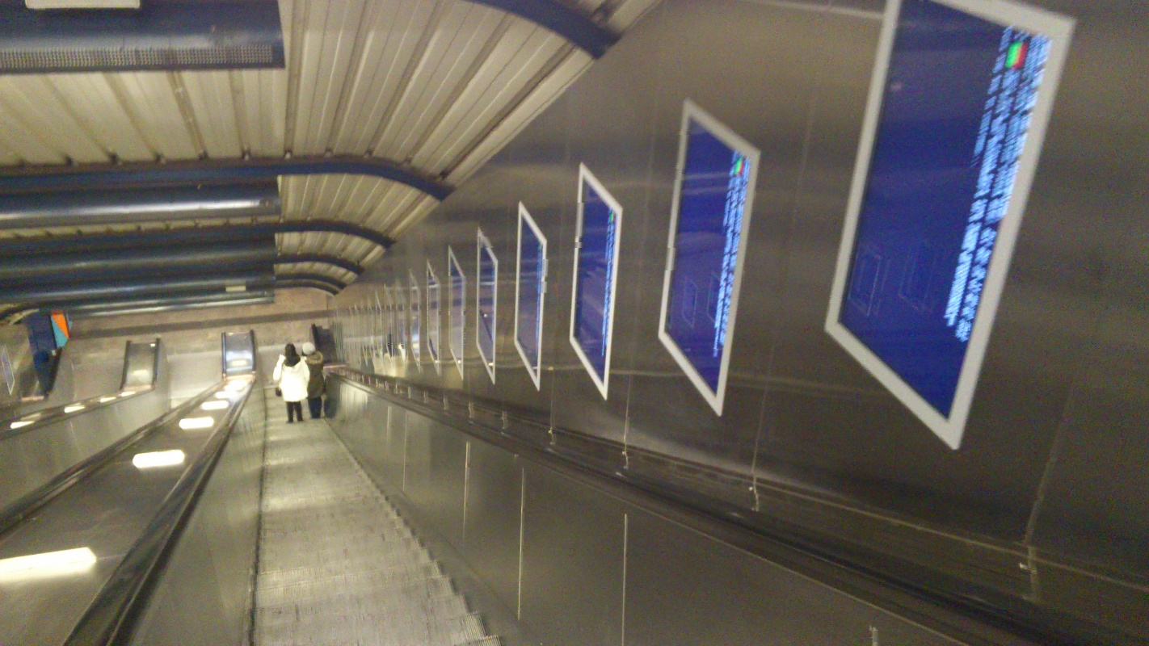
But what about every-day life in Oslo???

Slide 14
Why??? A common problem… no tests!

Slide 15
Software Testing
Software has bugs, ie implementation mistakes
All developers write bugs, not just students, even senior ones
eg, in the writing of the code of this course there were (and might still be) several bugs, which you can check by looking at the commit logs in the Git history
Testing helps you to find bugs before it is delivered to customers
However, testing does NOT guarantee the absence of bugs…

Slide 16

Manual Testing
Start the application you are developing
Use it, and manually check if it is working correctly
eg, should not crash and should get expected behavior
Try to follow common usage scenarios for the application
Also try uncommon scenarios, to check if still working correctly
Software Tester: an employee whose work is to test the application before each new release/feature

Slide 17
Problems of Manual Testing
Many people finds it boring…
It is not systematic: a manual procedure can miss/forget to test important scenarios and edge cases
It is expensive: software testers still need a salary to feed their families…
Every time there is a code change, new bugs might be introduced, and previous testing is invalidated
ie, have to do it again, and again, and again, and …
Still, you need to have a manual testing phase (eg before a major release to customers), but you also need something more besides manual testing

Slide 18
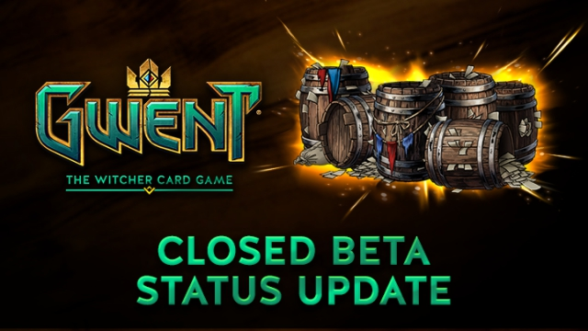

Beta Testing
A type of manual testing you might be familiar with, especially in regards to video-games
Release the software in a “beta” state to a group of potential users, which will test it for free!
Very common in online games, especially to test large loads on servers before a main release

Slide 19
Testing Depends on Context
If there is a bug in a video-game, players will just have a to wait for a patch…
although if too many bugs at launch, it will hurt sales…
If there is a bug in an enterprise system dealing with critical assets (e.g., a bank), you might be screwed…

Slide 20
Automated Testing
Write code that can automatically run tests against an application, or parts of it (e.g., single functions or classes)
Benefits:
you can tests single parts of the application
can re-execute all tests every time there is a code change to see if these new changes break current functionalities

Slide 21
Kinds of Testing
Unit Testing
test units (functions/classes) in isolation
Integration Testing
scenarios in which different components are involved
System Testing
test the whole application, going through the same interfaces (e.g., a GUI) that a user would use to interact with it
But there are many others
User Testing, Security Testing, Performance Testing, Robustness Testing, etc.

Slide 22
Running Tests in Java
The main framework is JUnit
others are like for example TestNG and Spock
Not just for unit testing, but any kind of testing
eg, the Arquilliain and Spring service tests can be considered as integration tests

Slide 23
Maven and Tests
Maven can run tests as part of the build
It makes distinctions between unit and integration tests
But these are JUST names, and NOT necessarily related to the concepts of unit and integration testing
ie, could run unit tests in Maven like they were integration ones
unit: run by Surefire plugin, name pattern “*Test.java”, executed BEFORE the “mvn package” phase (jar/war file not built yet)
integration: run by Failsafe plugin, name pattern “*IT.java”, executed AFTER “mvn package” (so can use the built JAR/WAR file)

Slide 24
When to use “*IT.java”
If your tests need to use the generated JAR/WAR file
eg, you want to start the actual built application
If your tests are long to execute (e.g., system tests), and you do not want to run them each time you just need to do a “mvn package”
eg, you just want to quickly build the application for some manual testing

Slide 25
Selenium

Slide 26
Selenium
Tool that enables you to interact and control a browser from code
Written in Java, but used as a tool in many different languages, eg C#/.Net
Main use: ability to write system tests for web applications, in which you first start the server, and the control the browser (eg click buttons) like it was a real user

Slide 27
Selenium Requirements
In Java, imported as a JAR library
Can be called directly from JUnit
MUST have a browser (e.g., Chrome) AND the Selenium drivers for such browser (which you need to install separately)
Note: can also use Docker to run an image with a browser and drivers already configured… but then it is more difficult to debug, as no simple direct access to the browser GUI running inside the Docker image
Note: can run same tests against different browsers

Slide 28
HTML Interactions
For Selenium to interact with the HTML components, it needs to locate them first
Easiest way is to add “id” attributes to the HTML tags we want to click on or type inputs in
At times though, we need more sophisticate queries
eg, check how many rows there are in a table, or how many tags have a specific attribute
Needed for validation: e.g., after you click a button, you want to check that indeed a new row was added on a displayed table

Slide 29
XPath
Query language on tags in HTML/XML documents

Slide 30
Unit vs System Tests

Slide 31
Mockito/PowerMock

Slide 32
Test Maintenance

Slide 33
JaCoCo

Slide 34
Instrumentation

Slide 35
Git Repository Modules
NOTE: most of the explanations will be directly in the code as comments, and not here in the slides
intro/spring/testing/selenium/jsf-tests
misc/test-utils
intro/spring/testing/selenium/crawler
intro/spring/testing/coverage/jacoco
intro/spring/testing/coverage/instrumentation
Exercises for Lesson 09 (see documentation)

